Slide 1



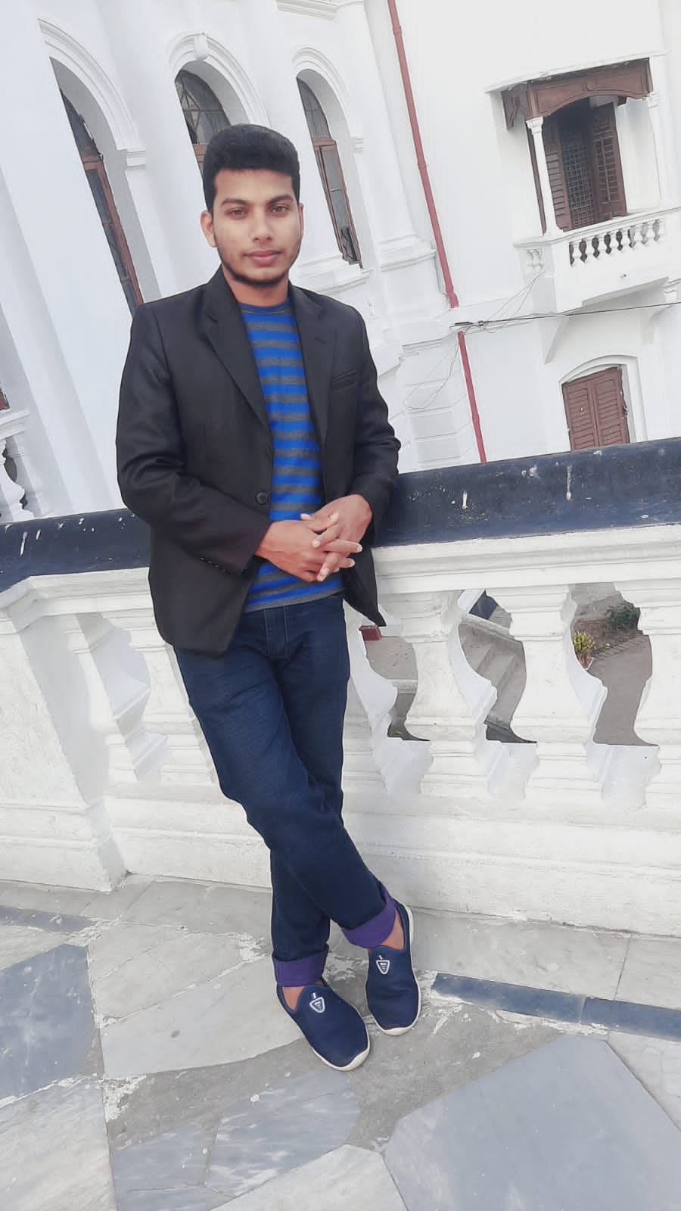
VIRTUAL PRESENTATION
ON
SELF-INTRODUCE
Presenter
MD HUMAUN FARID SOHAG

Slide 2
WELCOME
To my presentation
02

Slide 3
First of all, thankyou for
giving me a chance
to introduce myself.
03

Slide 4
BULLET POINT
About me
My family
Educational qualification
Skills
Hobbies
Goal
04

Slide 5

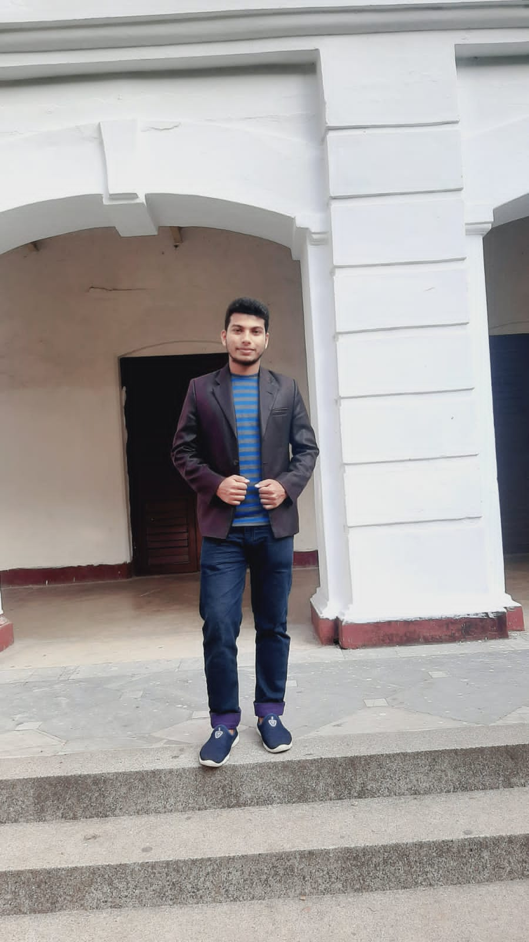
About me
This is MD Humaun Farid Sohag.
I have come from Pirganj,Rangpur
where I was born and grown.
05

Slide 6

Family
I have a family of four members.
Except my father and mother,
I have a little sister.
06

Slide 7
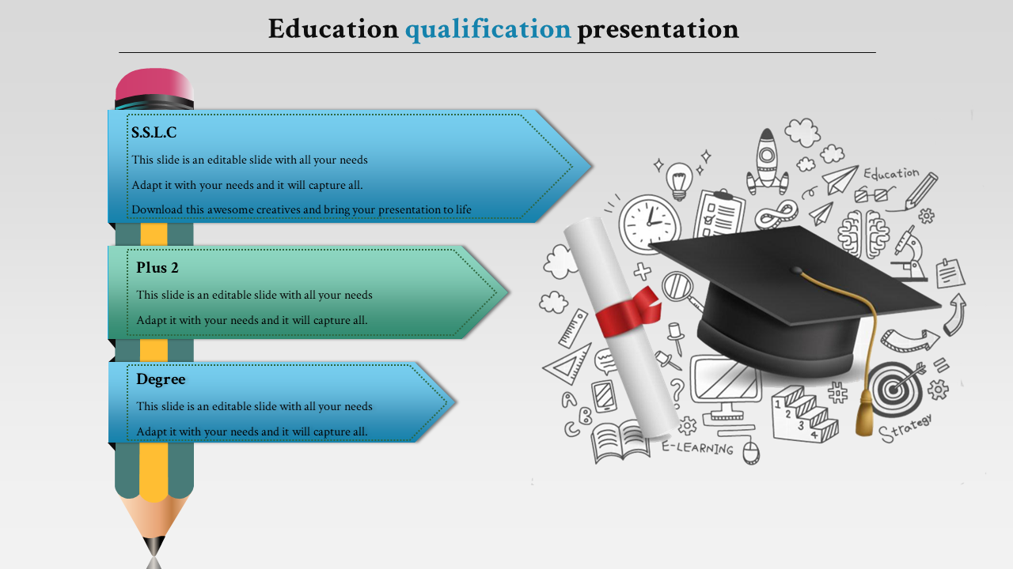
Educational Qualification
Secondary School Certificate (S.S.C) :
GPA- 5, Group : Science, Barudah High School, Pirganj, Rangpur, Passing Year : 2017 , Board : Dinajpur
Higher Secondary Certificate (H.S.C) :
GPA- 4.50, Gpoup: Science ,Rangpur Govt Collage , Rangpur. Passing Year : 2019 , Board : Dinajpur.
Bachelor of Science (B.Sc. Hon’s) :
I am currently studying in Statistics depertment at
Begum Rokeya University,Rangpur,Bangladesh.
07

Slide 8


Typing
Microsoft
office
SKILLS
Graphic
Designer
Time
Management
08

Slide 9





Hobbies
Travelling
Playing
Reading
Watching Drama
Skill Developing
09

Slide 10

Goal
I want to become a BCS cadre.
10

Slide 11
THANK YOU
For Your Attention

